Slide 1

Homework Assignment for Growth Analytics Platform Manager
Rafael Fagundes
Nov 2024

Slide 2

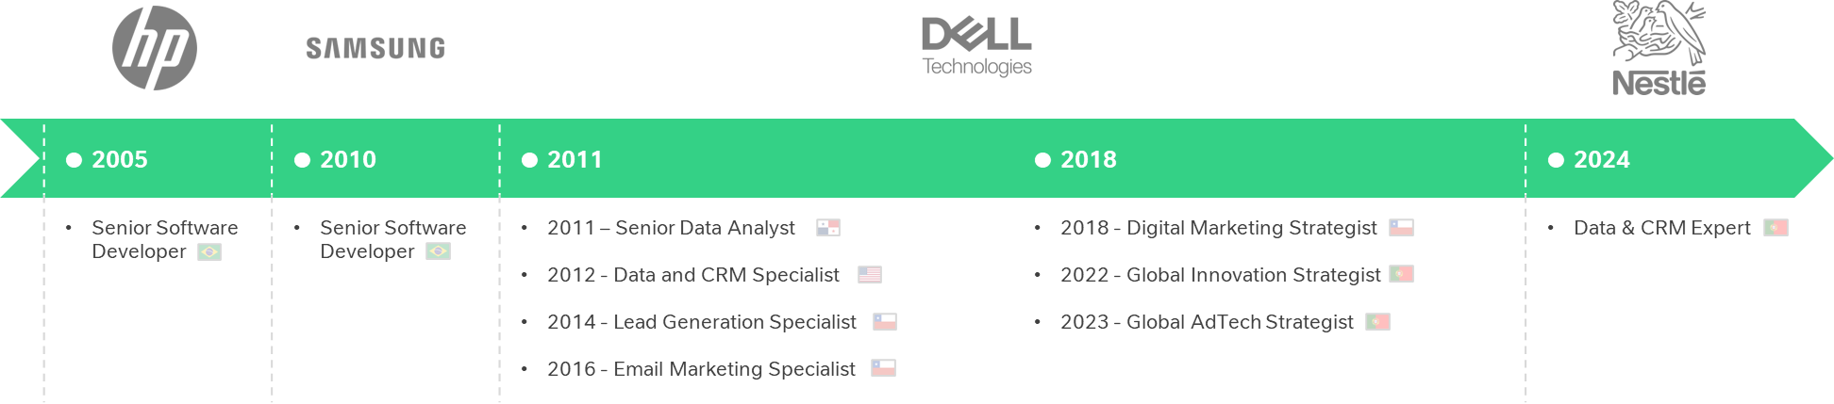
About me
Rafael Fagundes
Lisbon, Portugal
Computer Engineer
linkedin.com/in/rsfagundes |rsfagundes.com
With 10+ years in data analysis and marketing, I specialize in scalable solutions and automation using tools like SQL and Python. I’m excited to support Bolt’s mission by empowering Growth Analysts and driving efficiency.

Slide 3
1. Peak Hour Problem

Slide 4
Considerations
The main challenge in this homework was interpreting the dataset, its definitions, and its practical application. Below is the logic I used for calculating the main metrics:
Demand is the total users requesting rides, calculated as unmet demand (users who saw 0 cars) plus met demand (users who saw +1 cars). Supply represents driver availability, based on users who saw at least one car.
To calculate Additional Hours Needed, I first determined Coverage per Online (Field ID 20), showing coverage achieved per driver hour, then calculated the Coverage Deficit (Field ID 21) as the gap to the 100% threshold. Using these, I computed Additional Hours Needed (Field ID 22) by dividing the deficit by coverage efficiency. Finally, I verified accuracy by checking the new coverage ratio, now at 100%.
The Compensation is the difference between the Guaranteed Income, calculated using hourly guarantees based on the Hour Rate (Driver Income / Online (h)) and Total Required Hours (Online (h) + Additional Hours Needed), and the actual Driver Income.
The next slide presents the calculated fields along with their descriptions.

Slide 5
FIELD ID | FIELD NAME | DESCRIPTION | FORMULA | SAMPLE
1 | Date_Hour | Date and hour |  | 2016-12-18 23
2 | Date | Date of the event |  | 12/18/2016
3 | Hour | Hour of the event |  | 23
4 | Weekday | Day of the week (numeric) |  | 6
5 | Weekday Name | Day of the week (text) |  | Sunday
6 | Month | Month (numeric) |  | 12
7 | Month Name | Month (text) |  | December
8 | Active drivers | Number of active drivers (any level of activity) available |  | 52
9 | Online (h) | Total supply hours available | Has booking (h) + Waiting for booking (h) | 11 + 6 ≈ 18
10 | Has booking (h) | Total hours when drivers had a client booking (any state) |  | 6
11 | Waiting for booking (h) | Total hours which drivers spent waiting for booking |  | 11
12 | Hours per active driver | Average number of hours each driver was online | Online (h) / Active drivers | 18 / 52 = 0.3
13 | Rides per online hour | Average finished trips per online hour | Finished Rides / Online (h) | 12 / 18 = 0.67
14 | Finished Rides | Number of finished trips |  | 12
15 | People saw 0 cars (unique) | Number of users who did not see a car |  | 9
16 | People saw +1 cars (unique) | Number of users who saw at least a car |  | 32
17 | Coverage Ratio (%) | Proportion of users who saw at least a car | People saw +1 cars (unique) / Total People | 32 / 41 = 78%
18 | Demand | Total demand | People saw 0 cars (unique) + People saw +1 cars (unique) | 32 + 9 = 41
19 | Supply | Total supply | People saw +1 cars (unique) | 32
20 | Coverage per Online | Coverage per online hour | Coverage Ratio (%) / Online (h) | 78 / 18 = 4.33
21 | Coverage Deficit | Deficit in coverage | Coverage Threshold - Coverage Ratio (%) | 100 - 78 = 22
22 | Additional Hours Needed | Additional hours needed to reach full coverage | Coverage Deficit / Coverage per Online | 22 / 4.33 ≈ 5.08
23 | New Coverage Ratio | Expected coverage ratio with additional hours | Coverage per Online * (Online (h) + Additional Hours Needed) | 4.33 * (18 + 5.08) = 100
24 | Additional Rides | Additional rides expected by solving missed coverage | People saw 0 cars (unique) | 9
25 | Total Revenue | Total revenue generated | Finished Rides * Average Finished Ride Value | 12 * 10€ = 120€
26 | Driver Income | Income earned by drivers (80% of total revenue) | Finished Rides * Average Finished Ride Value * Driver Share | 12 * 10€ * 80% = 96€
27 | Hour Rate | Driver income per online hour | Driver Income / Online (h) | 96 / 18 ≈ 5.33
28 | Guaranteed Income | Income guaranteed to drivers | Hour Rate * (Online (h) + Additional Hours Needed) | 5.36 * (18 + 5.08) = 123.7€
29 | Compensation | Compensation paid by the company to meet guaranteed income | Guaranteed Income - Driver Income | 123.7 - 96 = 27.7€
*Calculated fields

Slide 6
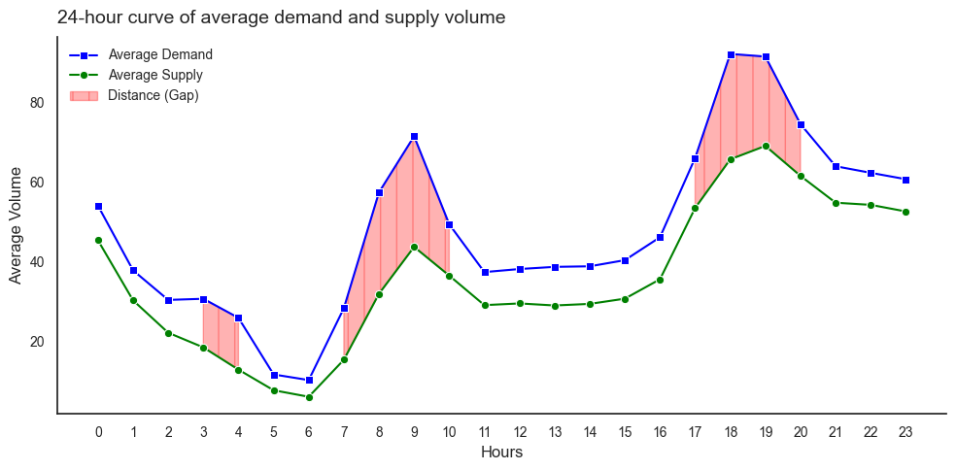
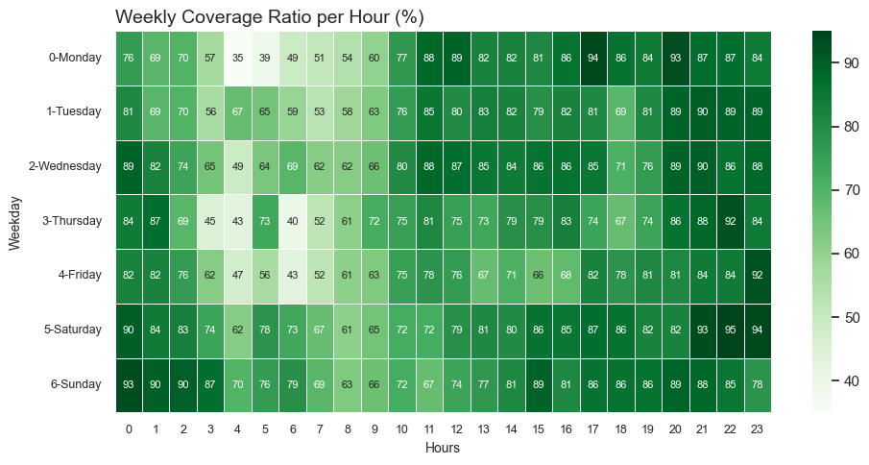
1. Critical Undersupply Periods: Analysis and Insights for Optimized Driver Availability
The chart highlights significant demand-supply gaps during early mornings (3-4 AM), morning commutes (7-10 AM), and evening peaks (5-8 PM), suggesting the need for targeted driver incentives to improve coverage and reduce missed opportunities. | The weekly coverage ratio per hour chart illustrates the demand-supply gaps, emphasizing critical peak hours. This information can be shared with drivers to incentivize their availability during undersupplied periods. Targeted notifications and bonus structures during these hours can help improve coverage, reduce unmet demand, and enhance rider satisfaction.

Slide 7
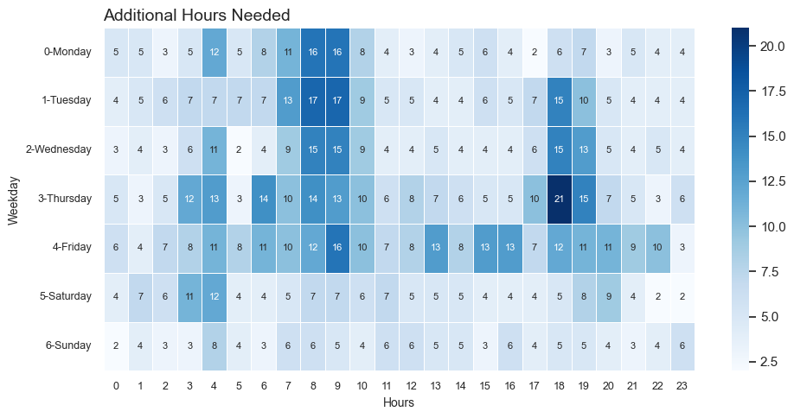
2. Optimizing Coverage: Required Online Hours for Peak Periods
The chart illustrates the required additional online hours to achieve a 100% coverage ratio. It highlights the critical undersupplied periods, enabling us to target specific hours where driver availability is insufficient. By incentivizing drivers during these times, we can close the demand-supply gap, improve service quality, and ensure rider satisfaction. Additionally, this data can guide the optimization of operational strategies, such as adjusting guaranteed income schemes or deploying targeted promotions.

Slide 8
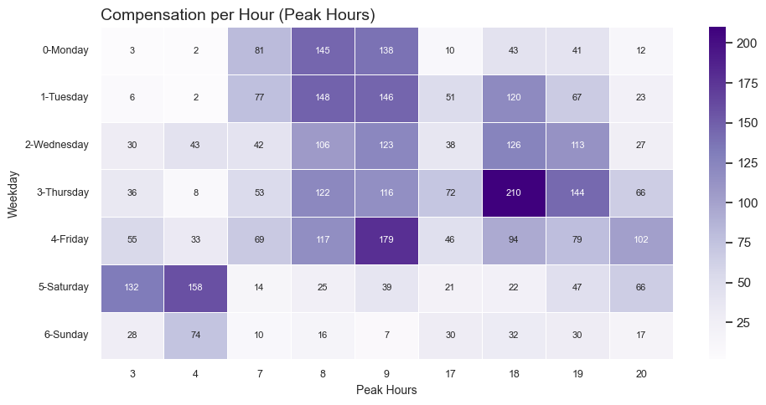
3. Guaranteed Earnings Analysis: Attracting Drivers During Peak Hours
The chart shows compensation per hour during peak periods, illustrating how guaranteed income attracts drivers during undersupplied hours. For example, on Friday at 9 AM, a compensation of €179 ensures that if a driver’s earnings fall short, Bolt pays the difference, motivating drivers to stay active and reducing coverage gaps. Aligning incentives with demand peaks improves rider satisfaction and operational efficiency.

Slide 9
2. Scaling Growth Analytics Operational Support

Slide 10

Challenges and Recommended Approach
CURRENT SITUATION | PROPOSED SOLUTION
Bolt operates in 50+ countries and 600 cities. Growth Analysts manually manage campaigns for only 100 cities. The remaining 500 cities lack automated campaign execution. Headcount constraints limit scaling manual efforts. Need an automated solution to support rider discounts and driver bonuses efficiently. | Campaign Management Platform Implementation A scalable solution to ensure scalability, efficiency, and market growth through: Dynamic Incentives: Automates rider discounts and driver bonuses to address demand-supply gaps. Optimized Allocation: Targets high-value users using segmentation to maximize ROI. Monitoring: Real-time dashboards and alerts for tracking campaign performance. Continuous Improvement: Feedback loops, A/B testing, and model updates to refine strategies.

Slide 11





Necessary Considerations and Teams to Involve
DEMAND-SUPPLY DYNAMICS
Automate incentives based on real-time data to address peak demand or supply shortages effectively.
SCALABILITY AND COMPLIANCE
Adapt campaigns to local market conditions while ensuring legal and regulatory compliance.
USER SEGMENTATION
Target high-value riders and active/inactive drivers with tailored discounts or bonuses.
TEAMS TO INVOLVE
Data Science, Engineering, Marketing, Product, Legal, and Operations for end-to-end automation and monitoring.
FRAUD PREVENTION
Implement caps and anomaly detection to minimize misuse of campaigns.

Slide 12


Campaign Management Platform Design and Features
PLATFORM DESIGN | MONITORING AND INTERVENTION MECHANISMS
Dynamic Templates: Predefined, adjustable templates for discounts and bonuses. Real-Time Data Integration: Continuously update campaigns based on demand-supply dynamics. Scalable Architecture: Cloud-based system to manage 500+ cities efficiently. Fraud Prevention: Built-in anomaly detection and usage caps for incentives. Performance Dashboards: Visualize metrics like ROI, engagement, and demand-supply gaps. | Real-Time Alerts: Identify underperforming campaigns or anomalies automatically. Dynamic Adjustments: Adjust incentives during peak hours or based on demand-supply gaps. Fraud Detection: Spot and mitigate incentive misuse with anomaly algorithms. Engagement Metrics: Track rider and driver activity to evaluate campaign effectiveness. Manual Overrides: Allow analysts to intervene in unforeseen local events or market dynamics.

Slide 13
Key Metrics for Performance Tracking
METRIC | PURPOSE | IMPORTANCE
Campaign ROI | Measure the cost-effectiveness of discounts and bonuses. | Ensures resources are allocated efficiently, identifies impactful campaigns, and maximizes return on investment.
Rider Engagement | Track acquisition, retention, and trip frequency. | Helps understand customer behavior, improve satisfaction, and build long-term loyalty.
Driver Activity | Monitor online hours, availability, and ride completions. | Maintains a balanced platform, ensures sufficient active drivers, and optimizes driver earnings and efficiency.
Demand-Supply Gaps | Assess service quality and coverage improvements. | Provides insights to close gaps, improving rider satisfaction, reducing wait times, and enhancing performance.
Market Share Growth | Evaluate competitive positioning and revenue impact. | Measures the success of growth strategies, monitors competitiveness, and ensures sustained expansion.

Slide 14
Continuous Improvement
PERFORMANCE REVIEWS
Continuously evaluate and adapt based on campaign outcomes
FEEDBACK LOOPS
Collect input from riders, drivers, and analysts for refinements
PLAYBOOK REFINEMENT
Document and share successful practices across markets
A/B TESTING:
Experiment with campaign parameters to identify optimal strategies
DATA-DRIVEN UPDATES
Regularly enhance segmentation and forecasting models

Slide 15





Measuring and Quantifying Project Impact
CAMPAIGN ROI
Assess the cost-effectiveness of discounts and bonuses.
MARKET SHARE
Track growth in rider and driver adoption rates.
REVENUE GROWTH
Compare revenue increases in automated vs. manual cities.
OPERATIONAL EFFICIENCY
Measure time saved by analysts through automation.
DEMAND-SUPPLY IMPROVEMENTS
Analyze reductions in service gaps and wait times.

Slide 16
Conclusion and Next Steps
The Campaign Management Platform will automate campaign processes, driving scalability, enhancing efficiency, and fostering market growth.
NEXT STEPS:
PILOT PROGRAM | FEEDBACK INTEGRATION | PROGRESSIVE ROLLOUT | CONTINUOUS OPTIMIZATION
Test automation in a subset of 50 cities to validate the approach. | Collect and analyze results to refine the platform and strategies. | Gradually implement the solution across all 500 cities, leveraging insights from the pilot phase. | Regularly update models, playbooks, and workflows for long-term success.

